Slide 1

LA 2028 OLYMPIC TRANSPORT GUIDE
MILESTONE 1
Team Members-
Rhett Carter
Stephen Keyen
Rohini Vishwanathan
Tracy Gaolese
Charlize Andaya

Slide 2
Agenda
PROJECT OVERVIEW
USER STORIES
DEMONSTRATION
TESTING
AGILE METHODS
FUTURE DEVELOPMENT

Slide 3
PROJECT OVERVIEW
Problem Statement:
With the Olympic Games coming to Los Angeles in 2028 and the world cup being spread across North America, we believe that there is need for a transportation app that benefit visitors as they traverse the city to attend their events.
Functionalities for the Final Product:
Search function for nearby transportation to the users starting point and destination
Cost and Timing Estimates for routes
Filtering by budget
Filtering by sustainability options
Integrate Ride Sharing (Uber, Lyft, etc.)
For this project, we intend to use:
Flask
Folium
Google Maps API
LA Metro Transit API

Slide 4
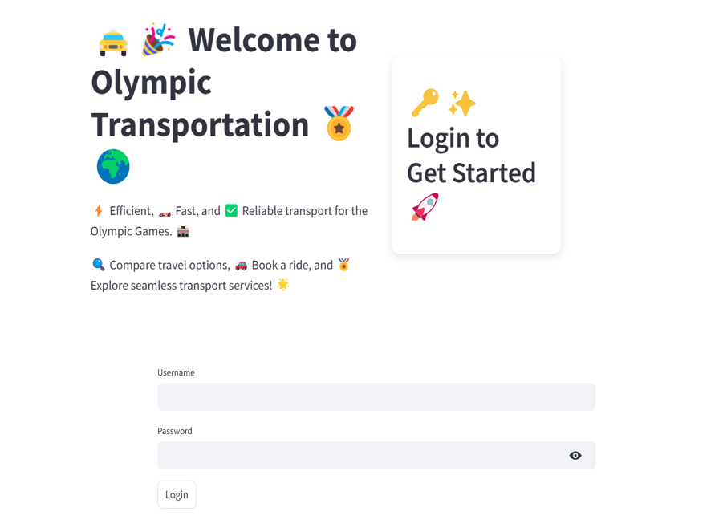
Landing Page With Login Option
Key Features:
App opens on a login page with a theme for our project
Login Routes to the application
For now, there is only one login credential, but we are looking to expand this in future iterations

Slide 5
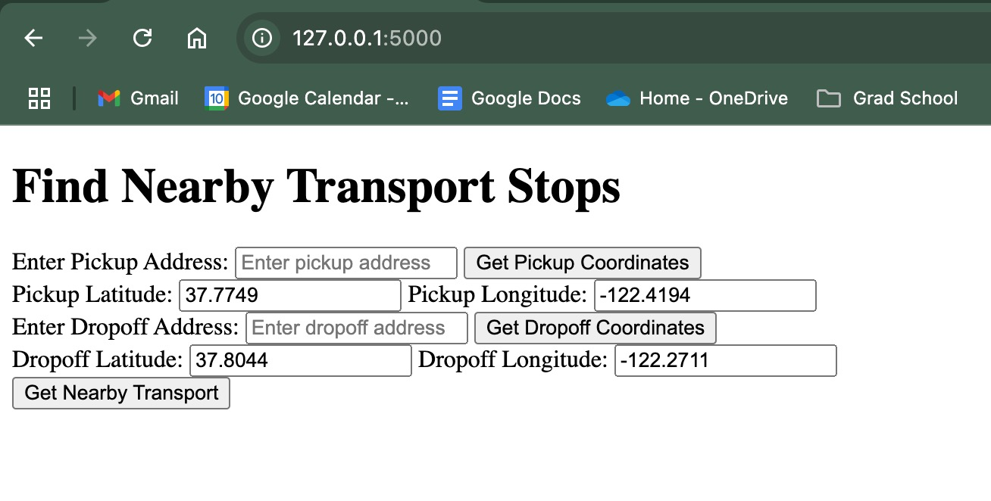
User Story 1:
As a user, I want to be able to search for input pickup and dropoff destinations and mark them on a map
Key Features:
Search bar that takes in addresses or lat/long coordinates
Backend will translate the addresses into lat/long coordinates
Generates a map using the google maps API

Slide 6
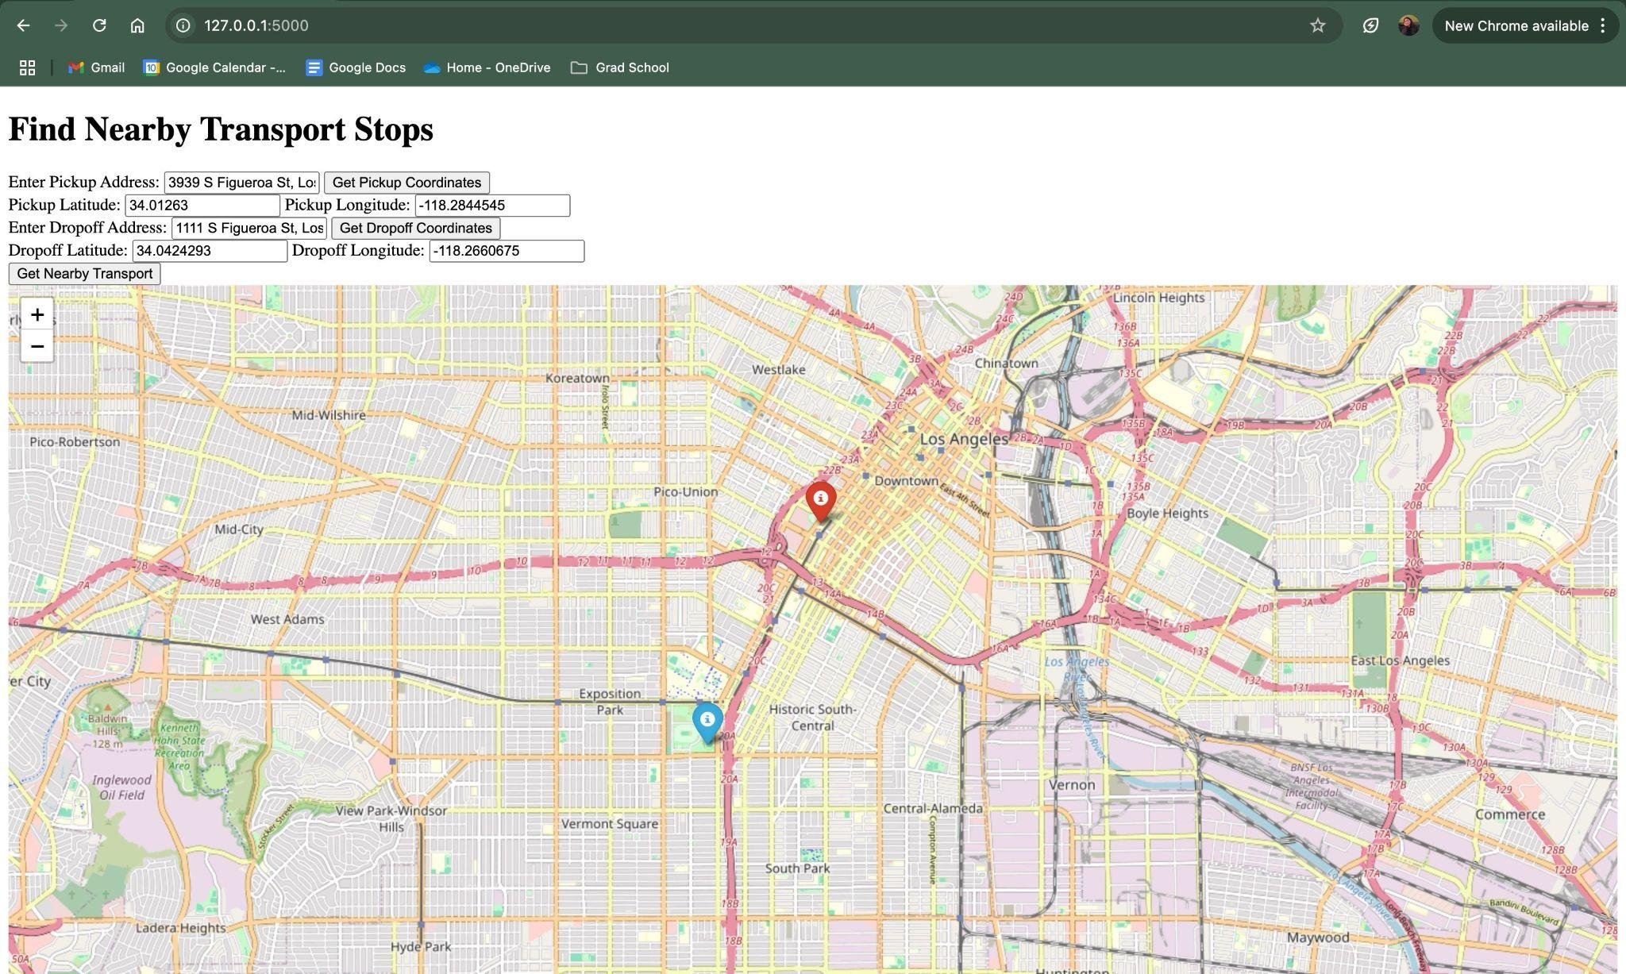
User Story 2:
As a user, I want to see the nearest public transport stations so that I can easily access transport options
Key Features:
Generates map with markers on the input addresses
Shows the names of the nearest stations to input addresses

Slide 7
Time for a Demonstration of User Stories 1 & 2

Slide 8
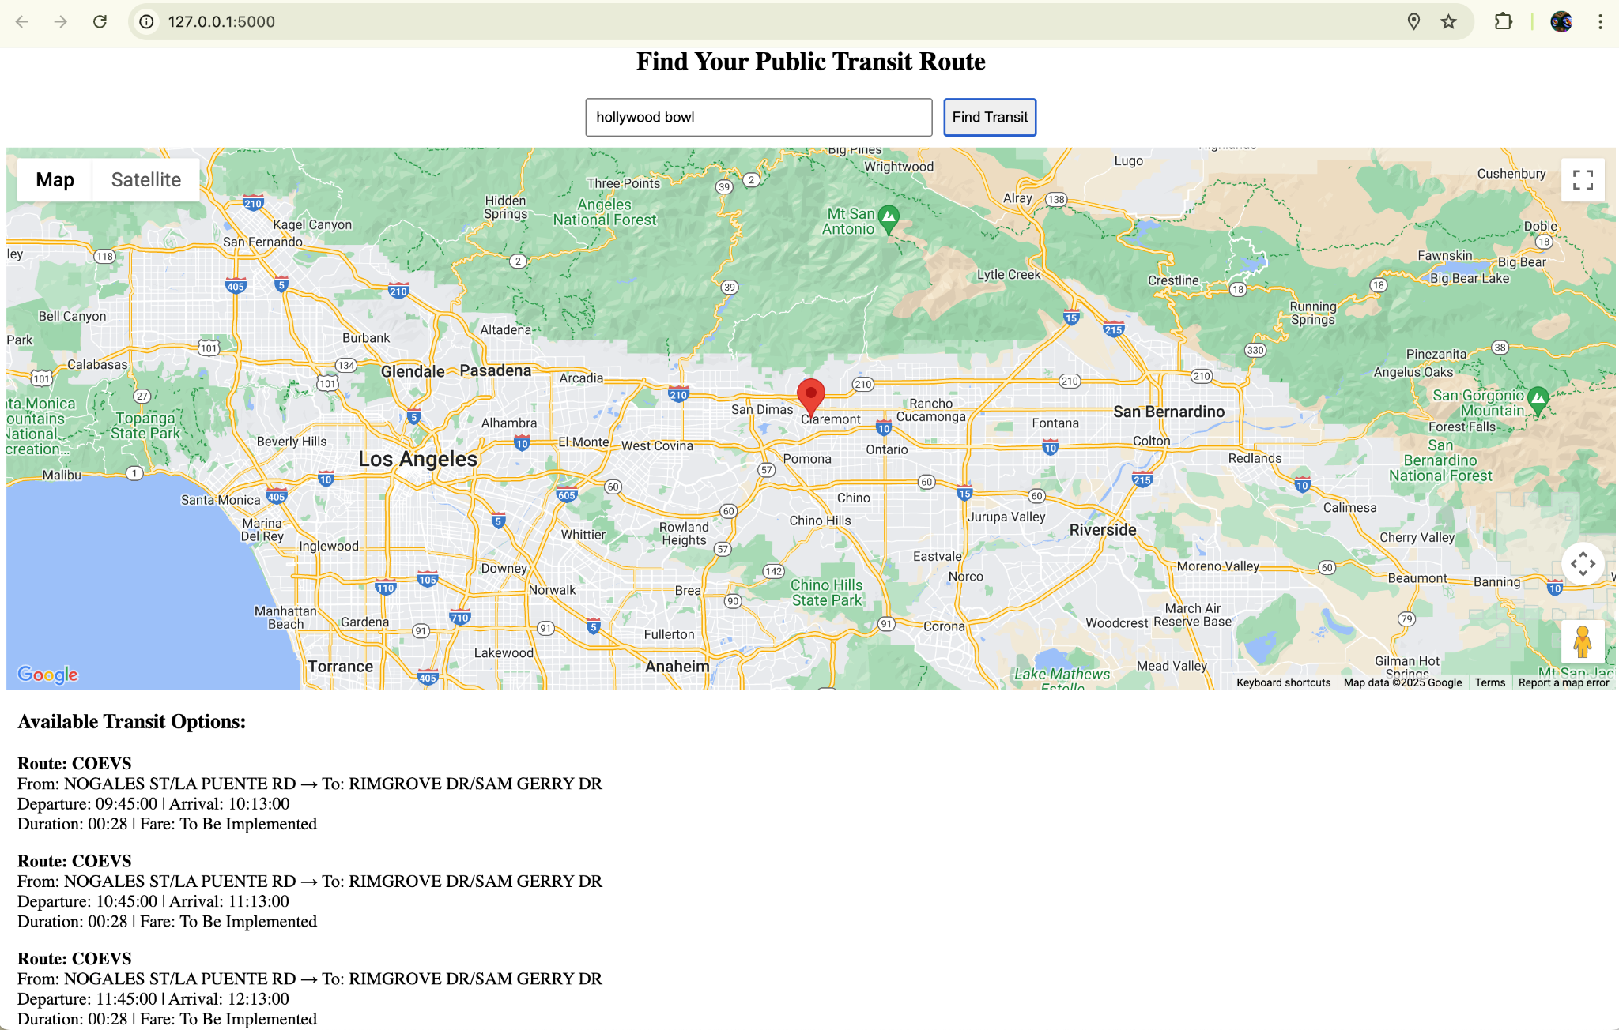
User Story 3:
As a visitor, I want to see estimated travel time and cost for each transport option so that I can plan my trip effectively.
Key Features:
Key Features: A search Bar, for user destination which results in a list of Bus/Train routes, with different bus arrival times during the day and trip durations.

Slide 9
Time for a Demonstration of User Stories 3

Slide 10
TESTING THE CODE
Unit Testing:
For User Story 1 we ran the code while verifying the search bars populated and that the map was generated with location markers
For User Story 2 we also verified that the interactive map was responsive to the user and that the map displayed transport station near the specified pickup and dropoff addresses
For User Stories 1 & 2 we wrote in print statements and API checks to verify the code was working properly
Integration Testing:
We tested the integration of User Stories 1 & 2 to ensure that nearby transit locations populated for the input set of addresses
We were not able to do integration testing for User Story 3 to date because of a file size issue
System Testing:
We input addresses and verified the address markers were correct, then we verified that the highlighted transportation options nearby were actually where they appeared on the map

Slide 11
AGILE METHODOLOGY
We Chose to use the Scrum Method for this project
Sprints:
We decided to implement 4 week sprints where each team member was assigned various tasks
Collaboration:
Our group met at least twice a week: Sundays and Wednesdays
More meetings were held as needed, including a week with four meetings
Worked as a group to implement the google maps API, and to explore the Lyft and Uber APIs
Responding to Change:
We initially set out to finish 5 user stories for Milestone 1, but quickly realized this was not achievable
Scaled back Milestone 1 to include 3 user stories
Focused on quality and working code over quantity
Version Control:
We centralize all of our code in the GitHub Repository
Have rolled back previous version of code that made the application not work
Allows group members to work on different portions of the code at the same time without hiccups
Roles:
Scrum Master:
Stephen
Developers:
Rhett
Charlize
Rohini
Tracy

Slide 12
NEXT STEPS FOR MILESTONE 2.0
Integrating user stories 1 & 2 with user story 3 (resolve the file size issue)
Adding filter options based on budget and sustainability preferences
Implementing multi stop transportation options
Connecting with the Uber and Lyft APIs to add ride sharing to our functionalities
Showing users multiple route options and allowing them to select the one that fits into their preferences
Challenges-
Overcoming file size issue
Ensuring reliable API integration- Navigating access restrictions for Uber, Lyft
Defining sustainability categories
Connecting stops and the various sub route information to create a full trip
Sorting route options based on criteria when they appear as options

Slide 13
Thank You!
Questions?

